Slide 1

The web-scale library
Cloud Computing enabling data-driven discovery and resource management
Marshall Breeding
Independent Consultant, Author, Speaker
Founder and Publisher, Library Technology Guides
http://www.librarytechnology.org/
http://twitter.com/mbreeding
October 24, 2012
Internet Librarian 2012

Slide 2
Abstract
One of the main vectors of change in library automation involves the emergence of a new slate of products that move libraries away from locally housed systems to global platforms. These new library services platforms offer libraries an opportunity to operate less in self-contained silos of data and functionality but rather to work in broad web-scale environments of highly shared data, unified workflows across the physical, digital, and electronic materials that comprise their collections. Discovery services have led the way toward this web-scale approach, and now library management is traveling a similar path. Breeding presents a conceptual overview of this new model of library automation and a practical update on the products and services within this new genre, providing their current status of development or deployment.

Slide 3
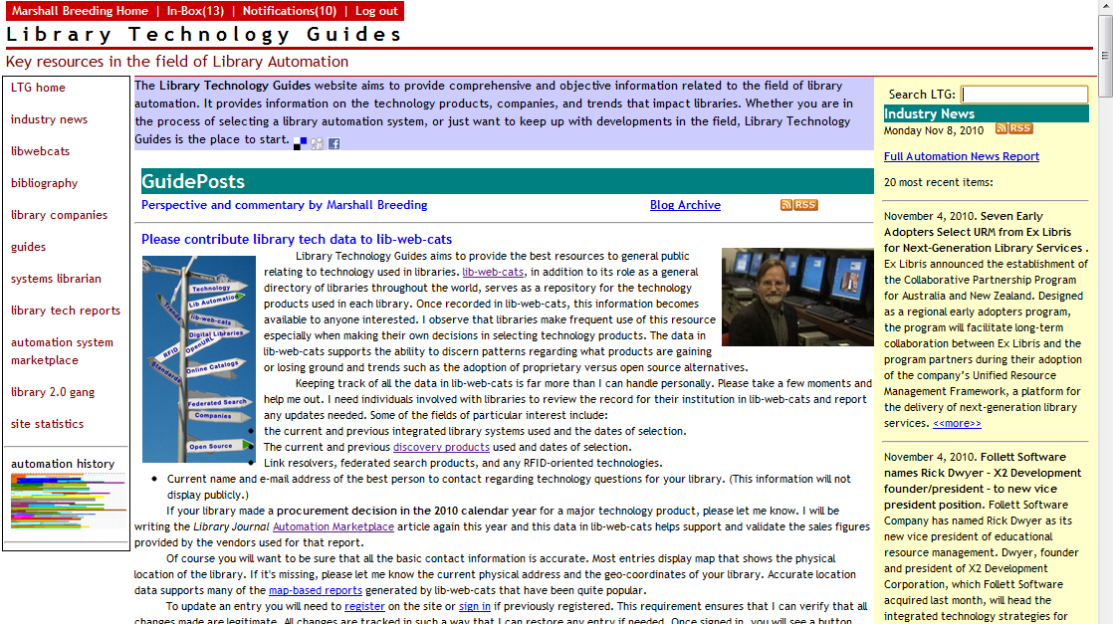
Library Technology Guides
www.librarytechnology.org

Slide 4
Appropriate Automation Infrastructure
Current automation products out of step with current realities
Majority of library collection funds spent on electronic content
Majority of automation efforts support print activities
New discovery solutions help with access to e-content
Management of e-content continues with inadequate supporting infrastructure

Slide 5
Key Context: Libraries in Transition
Academic Shift from Print > Electronic
  E-journal transition largely complete
  Circulation of print collections slowing
  E-books now in play (consultation > reading)
Public: Emphasis on Patron Engagement
  Increased pressure on physical facilities
  Increased circulation of print collections
  Dramatic increase in interest in e-books
All libraries:
  Need better tools for access to complex multi-format collections
  Strong emphasis on digitizing local collections
  Demands for enterprise integration and interoperability

Slide 6
Key Text: Changed expectations in metadata management
Moving away from individual record-by-record creation
Life cycle of metadata
  Metadata follows the supply chain, improved and enhanced along the way as needed
Manage metadata in bulk when possible
  E-book collections
Highly shared metadata
  E-journal knowledge bases, e.g.
Great interest in moving toward semantic web and open linked data
  Very little progress in linked data for operational systems
  AACR2 > RDA
  MARC > RDF (recent announcement of Library of Congress)

Slide 7
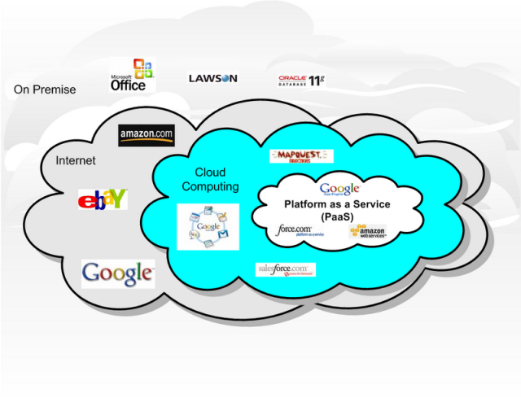
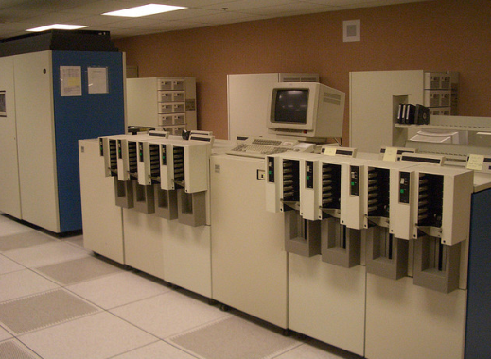
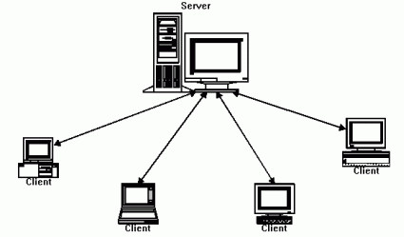
Fundamental technology shift
Mainframe computing
Client/Server
Cloud Computing
http://www.flickr.com/photos/carrick/61952845/
http://soacloudcomputing.blogspot.com/2008/10/cloud-computing.html
http://www.javaworld.com/javaworld/jw-10-2001/jw-1019-jxta.html

Slide 8
Cloud Computing
Major trend in Information Technology
Term “in the cloud” has devolved into marketing hype, but cloud computing in the form of multi-tenant software as a service offers libraries opportunities to break out of individual silos of automation and engage in widely shared cooperative systems
Opportunities for libraries to leverage their combined efforts into large-scale systems with more end-user impact and organizational efficiencies

Slide 9
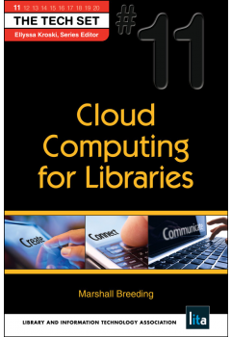
Cloud Computing for Libraries
Book Image
Publication Info:
Volume 11 in The Tech Set
Published by Neal-Schuman / ALA TechSource
ISBN: 781555707859
http://www.neal-schuman.com/ccl

Slide 10
Library Automation in the Cloud
Almost all library automation vendors offer some form of “cloud-based” services
Server management moves from library to Vendor
Subscription-based business model
Comprehensive annual subscription payment
  Offsets local server purchase and maintenance
  Offsets some local technology support

Slide 11
Software as a Service
Multi Tennant SaaS is the modern approach
  One copy of the code base serves multiple sites
Software functionality delivered entirely through Web interfaces
  No workstation clients
Upgrades and fixes deployed universally
  Usually in small increments

Slide 12
Data as a service
SaaS provides opportunity for highly shared data models
WorldCat: one globally shared copy that serves all libraries
Primo Central: central index of articles maintained by Ex Libris shared by all libraries implementing Primo / Primo Central
KnowledgeWorks database of e-journal holdings shared among all customers of Serials Solutions products
General opportunity to move away from library-by-library metadata management to globally shared workflows

Slide 13
Leveraging the Cloud
Moving legacy systems to hosted services provides some savings to individual institutions but does not result in dramatic transformation
Globally shared data and metadata models have the potential to achieve new levels of operational efficiencies and more powerful discovery and automation scenarios that improve the position of libraries overall.

Slide 14
Transition to Web-scale Technologies
Web-scale: a characterization or marketing tag that denotes a comprehensive, highly-scalable, globally shared model
Web-scale: One of the key characteristics of emerging library management and discovery services
Displaces applications or data models targeting individual libraries in isolation
Discovery: index-based search
Management: Library Services Platforms

Slide 15
A New Generation of Resource Discovery

Slide 16












Discovery Products
http://www.librarytechnology.org/discovery.pl
Notes:
Will you distinguish Open Source vs Proprietary?

Slide 17
Online Catalog
ILS Data
Search:
Scope of Search
Search Results
Books, Journals, and Media at the Title Level
Not in scope:
  Articles
  Book Chapters
  Digital objects

Slide 18
Next-gen Catalogs or Discovery Interface
Single search box
Query tools
  Did you mean
  Type-ahead
Relevance ranked results
Faceted navigation
Enhanced visual displays
  Cover art
  Summaries, reviews,
Recommendation services
Scope of Search
Books, Journals, and Media at the Title Level
Other local and open access content
Not in scope:
  Articles
  Book Chapters
  Digital objects

Slide 19
Discovery from Local to Web-scale
Initial products focused on interface improvements
  AquaBrowser, Endeca, Primo, Encore, VuFind,
  LIBERO Uno, Civica Sorcer, Axiell Arena
  Mostly locally-installed software
Current phase is focused on pre-populated indexes that aim to deliver Web-scale discovery
  Primo Central (Ex Libris)
  Summon (Serials Solutions)
  WorldCat Local (OCLC)
  EBSCO Discovery Service (EBSCO)
  Encore with Article Integration (no index, though)

Slide 20
Discovery Interface search model
ILS Data
Digital Collections
Search:
Local Index
ProQuest
Search Results
EBSCOhost
MetaSearch Engine
…
MLA Bibliography
ABC-CLIO
Real-time query and responses

Slide 21
Web-scale Index-based Discovery
ILS Data
(2009- present)
Digital Collections
Search:
Web Site Content
Institutional Repositories
Search Results
Consolidated Index
Aggregated Content packages
…
E-Journals
Reference Sources
Pre-built harvesting and indexing
Notes:
Your title is covered up with the ILS data content – DISCO instead of Discovery

Slide 22
Web-scale Search Problem
ILS Data
Digital Collections
Search:
Web Site Content
Institutional Repositories
Consolidated Index
Search Results
Aggregated Content packages
…
E-Journals
Pre-built harvesting and indexing
???
Non Participating
Content Sources
Problem in how to deal with resources not provided to ingest into consolidated index

Slide 23
Encore Synergy
ILS Data
Digital Collections
Search:
Local Index
ProQuest
Local Index Results
…
EBSCOhost
Remote Search Results
…
Web Services
MLA Bibliography
Local Index Results
ABC-CLIO

Slide 24
Discovery Service Installations
Discovery Product | 2007 | 2008 | 2009 | 2010 | 2011 | Installed
Primo | 12 | 37 | 53 | 506 | 111 | 914
AquaBrowser | 55 | 339 | 64 | 69 | 74 | 254
Encore | 72 | 72 | 109 | 56 | 72 | 326
LS2 PAC |  | 46 | 77 | 58 | 88 | 236
Summon |  |  | 50 | 164 | 214 | 407
Enterprise |  | 16 |  | 75 | 100 | 251
Civica Sorcer |  |  | 7 | 12 | 22 | 39
Axiell Arena |  |  | 61 | 57 | 33 | 76
Chamo |  |  | 10 | 34 | 7 | 51

Slide 25
Expanding the Depth of Discovery

Slide 26
Citations / Metadata > Full Text
Citations or structured metadata provide key data to power search & retrieval and faceted navigation
Indexing Full-text of content amplifies access
Important to understand depth indexing
  Currency, dates covered, full-text or citation
  Many other factors

Slide 27
Full-text Book indexing
HathiTrust: 11 million volumes, 5.3 million titles, 263,000 serial titles, 3.5 billion pages
HathiTrust in Discovery Indexes
  Primo Central (Jan 20, 2012) [previously indexed only metadata]
  EBSCO Discovery Service (Sept 8 2011)
  WorldCat Local (Sept 7, 2011)
  Summon (Mar 28, 2011)

Slide 28
Challenge for Relevancy
Technically feasible to index hundreds of millions or billions of records through Lucene or SOLR
Difficult to order records in ways that make sense
Many fairly equivalent candidates returned for any given query
Must rely on use-based and social factors to improve relevancy rankings

Slide 29
Challenges for Collection Coverage
To work effectively, discovery services need to cover comprehensively the body of content represented in library collections
What about publishers that do not participate?
Is content indexed at the citation or full-text level?
What are the restrictions for non-authenticated users?
How can libraries understand the differences in coverage among competing services?

Slide 30
Evaluating the Coverage of Index-based Discovery Services
Intense competition: how well the index covers the body of scholarly content stands as a key differentiator
Difficult to evaluate based on numbers of items indexed alone.
Important to ascertain now your library’s content packages are represented by the discovery service.
Important to know what items are indexed by citation and which are full text
Important to know whether the discovery service favors the content of any given publisher

Slide 31


Open Discovery Initiative
NISO Work Group to Develop Standards and Recommended Practices for Library Discovery Services Based on Indexed Search
Informal meeting called at ALA Annual 2011
Co-Chaired by Marshall Breeding and Jenny Walker
Term: Dec 2011 – May 2013
http://www.niso.org/workrooms/odi/

Slide 32
Balance of Constituents
Libraries
Publishers
Service Providers
Marshall Breeding, Vanderbilt University
Jamene Brooks-Kieffer, Kansas State University
Laura Morse, Harvard University
Ken Varnum, University of Michigan
Sara Brownmiller, University of Oregon
Lucy Harrison, College Center for Library Automation (D2D liaison/observer)
Michele Newberry
Lettie Conrad, SAGE Publications
Roger Schonfeld, ITHAKA/JSTOR/Portico
Jeff Lang, Thomson Reuters
Linda Beebe, American Psychological Assoc
Aaron Wood, Alexander Street Press
Jenny Walker, Ex Libris Group
John Law, Serials Solutions
Michael Gorrell, EBSCO Information Services
David Lindahl, University of Rochester (XC)
Jeff Penka, OCLC (D2D liaison/observer)

Slide 33
ODI Project Goals:
Identify … needs and requirements of the three stakeholder groups in this area of work.
Create recommendations and tools to streamline the process by which information providers, discovery service providers, and librarians work together to better serve libraries and their users.
Provide effective means for librarians to assess the level of participation by information providers in discovery services, to evaluate the breadth and depth of content indexed and the degree to which this content is made available to the user.

Slide 34

Timeline
Milestone | Target Date | Status
Appointment of working group | December 2011
Approval of charge and initial work plan | March 2012
Agreement on process and tools | June 2012
Completion of information gathering | October 2012
Completion of initial draft | January 2013
Completion of final draft | May 2013

Slide 35
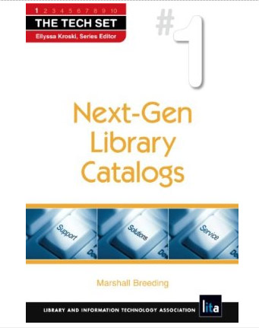
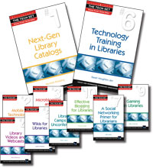
Next-Gen Library Catalogs
Marshall Breeding
Neal-Schuman Publishers
March 2010
Volume 1 of The Tech Set

Slide 36
New-generation Library Management

Slide 37
Is the status quo sustainable?
ILS for management of (mostly) print
Duplicative financial systems between library and campus
Electronic Resource Management (non-integrated with ILS)
OpenURL Link Resolver w/ knowledge base for access to full-text electronic articles
Digital Collections Management platforms (CONTENTdm, DigiTool, etc.)
Institutional Repositories (DSpace, Fedora, etc.)
Discovery-layer services for broader access to library collections
No effective integration services / interoperability among disconnected systems, non-aligned metadata schemes

Slide 38
Integrated (for print) Library System
Staff Interfaces:
Public Interfaces:
Interfaces
Business
Logic
Circulation
Cataloging
Acquisitions
Serials
Online
Catalog
Data
Stores
BIB
Holding
/ Items
Circ
Transact
User
Vendor
$$$
Funds
Policies

Slide 39
LMS / ERM: Fragmented Model
`
Staff Interfaces:
Public Interfaces:
Application Programming Interfaces
E-resource
Procurement
License
Management
Circulation
Cataloging
Acquisitions
Serials
Online
Catalog
Protocols: CORE
BIB
Holding
/ Items
Circ
Transact
User
Vendor
$$$
Funds
Policies
E-Journal
Titles
Vendors
License
Terms

Slide 40

Common approach for ERM
Staff Interfaces:
Public Interfaces:
Budget
License Terms
Application Programming Interfaces
Circulation
Cataloging
Acquisitions
Serials
Online
Catalog
Titles / Holdings
Vendors
BIB
Holding
/ Items
Circ
Transact
User
Vendor
$$$
Funds
Policies
Access Details

Slide 41
Comprehensive Resource Management
No longer sensible to use different software platforms for managing different types of library materials
ILS + ERM + OpenURL Resolver + Digital Asset management, etc. very inefficient model
Flexible platform capable of managing multiple type of library materials, multiple metadata formats, with appropriate workflows

Slide 42
Libraries need a new model of library automation
Not an Integrated Library System or Library Management System
The ILS/LMS was designed to help libraries manage print collections
Generally did not evolve to manage electronic collections
Other library automation products evolved:
  Electronic Resource Management Systems – OpenURL Link Resolvers – Digital Library Management Systems -- Institutional Repositories

Slide 43
Library Services Platform
Library-specific software. Designed to help libraries automate their internal operations, manage collections, fulfillment requests, and deliver services
Services
  Service oriented architecture
  Exposes Web services and other API’s
  Facilitates the services libraries offer to their users
Platform
  General infrastructure for library automation
  Consistent with the concept of Platform as a Service
  Library programmers address the APIs of the platform to extend functionality, create connections with other systems, dynamically interact with data

Slide 44
Library Services Platform Characteristics
Highly Shared data models
  Knowledgebase architecture
  Some may take hybrid approach to accommodate local data stores
Delivered through software as a service
  Multi-tenant
Unified workflows across formats and media
Flexible metadata management
  MARC – Dublin Core – VRA – MODS – ONIX
  New structures not yet invented
Open APIs for extensibility and interoperability

Slide 45
Beyond the legacy Library Management System
Find a new term for the successor to the LMS
Library Management System now viewed as print-centric
Need to designate a name for the new genre of automation products

Slide 46
Open Systems
Achieving openness has risen as the key driver behind library technology strategies
Libraries need to do more with their data
Ability to improve customer experience and operational efficiencies
Demand for Interoperability
Open source – full access to internal program of the application
Open API’s – expose programmatic interfaces to data and functionality

Slide 47
New Library Management Model
Unified Presentation Layer
Search:
Self-Check /
Automated Return
Consolidated index
Digital Coll
Library Services Platform
`
ProQuest
API Layer
Discovery Service
EBSCO
…
Stock
Management
JSTOR
Other Resources
Enterprise Resource
Planning
Smart Cad /
Payment systems
Learning
Management
Authentication
Service

Slide 48
Library Services Platforms
Category | WorldShare Management Services | Alma | Intota | Sierra Services Platform | Kuali OLE
Responsible Organization | OCLC. | Ex Libris | Serials Solutions | Innovative Interfaces, Inc | Kuali Foundation
Key precepts | Global network-level approach to management and discovery. | Consolidate workflows, unified management: print, electronic, digital; Hybrid data model | Knowledgebase driven. Pure multi-tenant SaaS | Service-oriented architecture Technology uplift for Millennium ILS. More open source components, consolidated modules and workflows | Manage library resources in a format agnostic approach. Integration into the broader academic enterprise infrastructure
Software model | Proprietary | Proprietary | Proprietary | Proprietary | Open Source

Slide 49
Development Schedule
WorldShare Management Services | Alma | Intota | Sierra Services Platform | Kuali OLE
General Release in July 2011 38 now in production | Development partners now in Release 5 General Release expected mid-2012 | Phase I: Late in 2012; Libraries in production by 2014 | Phase 1: Mid-2012 with full Millennium functionality; subsequent phases that expand model | Version 1.0 expected Dec 2012 Partners begin migration in 2013

Slide 50
Development / Deployment perspective
Beginning of a new cycle of transition
Over the course of the next decade, academic libraries will replace their current legacy products with new platforms
Not just a change of technology but a substantial change in the ways that libraries manage their resources and deliver their services

Slide 51
Recent ILS Industry Contracts
Company | Product |  | 2009 | 2010 | 2011
OCLC | WorldShare Management Services |  |  |  | 184
Innovative Interfaces | Sierra |  |  |  | 206
Ex Libris | Alma |  |  | 8 | 24
SirsiDynix | Symphony |  | - | 126 | 122
Innovative Interfaces, Inc. | Millennium |  | 45 | 39 | 32
The Library Corporation | Library.Solution |  | 30 | 43 | 48
Ex Libris | Aleph |  | 47 | 39 | 25
VTLS Inc. | Virtua |  | 18 | 22 | 13
Polaris Library Systems | Polaris ILS |  | 33 | 23 | 53
Biblionix | Apollo |  | 55 | 87 | 79
ByWater Solutions | Koha |  | 7 | 44 | 54
PTFS LibLime | LibLime Academic Koha |  |  |  | 7
PTFS LibLime | LibLime Koha |  |  | 44 | 27
Equinox Software | Evergreen |  | 18 | 15 | 21
Equinox Software | Koha |  |  |  | 6

Slide 52
Competing Models of Library Automation
Traditional Proprietary Commercial ILS
  Aleph, Voyager, Millennium, Symphony, Polaris,
  BOOK-IT, DDELibra, Libra.se
  LIBERO, Amlib, Spydus, TOTALS II, Talis Alto, OpenGalaxy
Traditional Open Source ILS
  Evergreen, Koha
New generation Library Services Platforms
  Ex Libris Alma
  Kuali OLE (Enterprise, not cloud)
  OCLC WorldShare Management Services,
  Serials Solutions Intota
  Innovative Interfaces Sierra (evolving)

Slide 53
Convergence
Discovery and Management solutions will increasingly be implemented as matched sets
  Ex Libris: Primo / Alma
  Serials Solutions: Summon / Intota
  OCLC: WorldCat Local / WorldShare Platform
  Except: Kuali OLE, EBSCO Discovery Service
Both depend on an ecosystem of interrelated knowledge bases
API’s exposed to mix and match, but efficiencies and synergies are lost

Slide 54
Questions and discussion

